Slide 1
MATLAB computation on Mie Scattering cross-section
Hosna Sultana

Slide 2
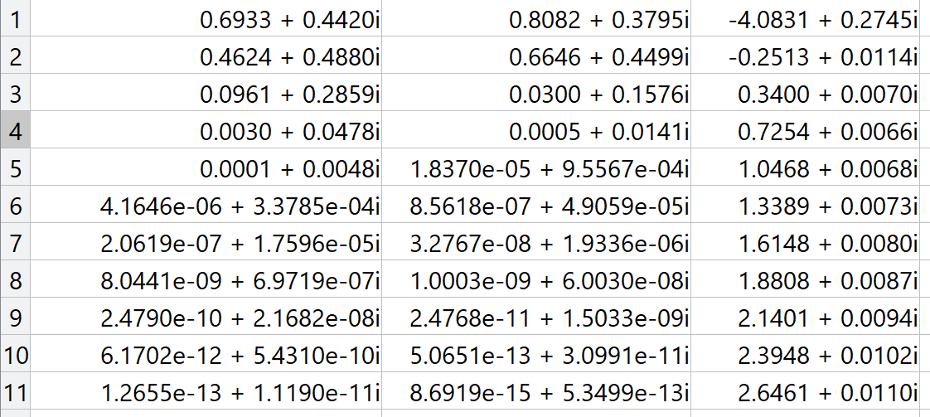
Mie scattering for Water droplet of a = 272.58467103348891669 nm, by for 500 nm wavelength of incident light
Optical index = (1.3660 + 0.005i)
Perpendicular incident light.
σ_{sca} = 0.517037734986008
σ_{ext} = 0.532188351120884
σ_{abs} = 0.015150616134876
σ_{back} = 0.015846921621502
n a_{n} | b_{n} | ZA

Slide 3
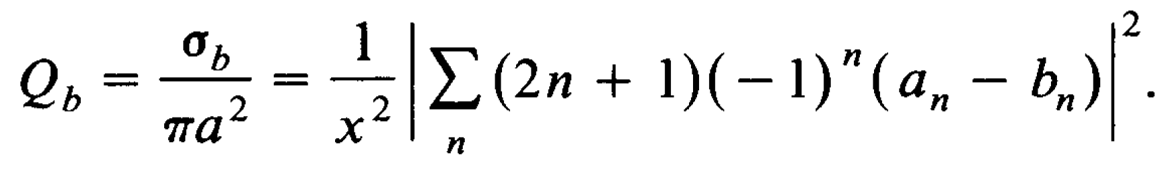
Mie scattering for Water droplet of a = 272.58467103348891669 nm, by for 500 nm wavelength of incident light
Q_{sca} = 2.214978468953743
Q_{ext} = 2.279883380644652
Q_{abs} = 0.064904911690909
Q_{back} = 0.001213525192936

Slide 4
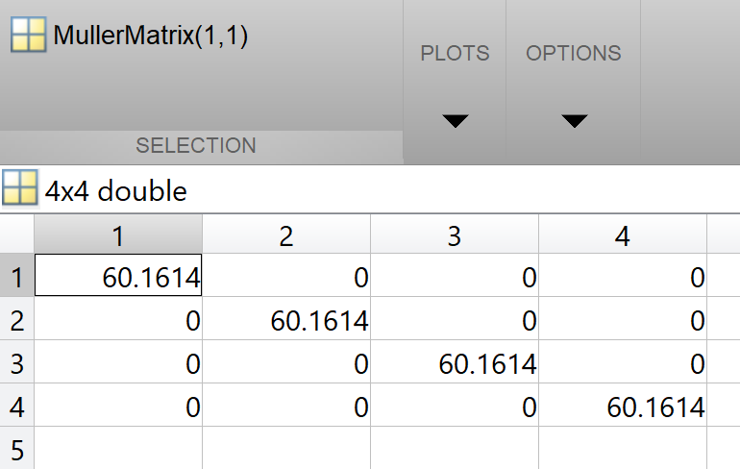
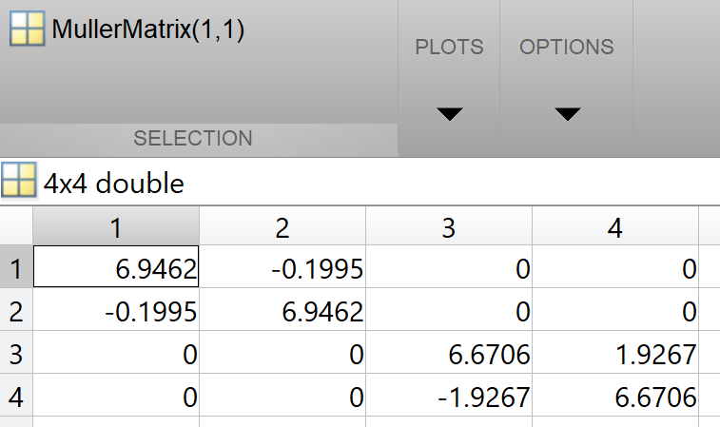
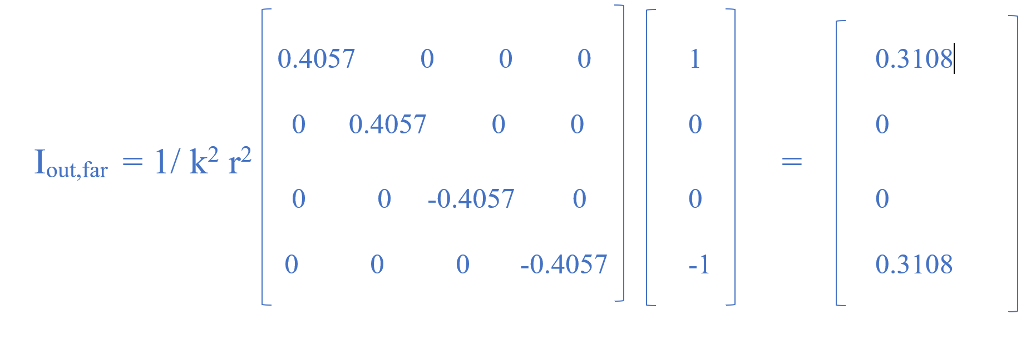
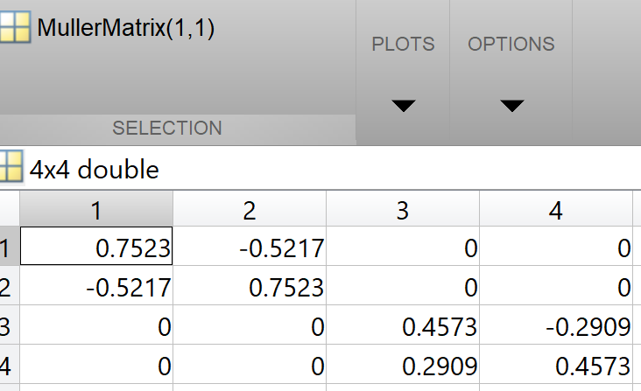
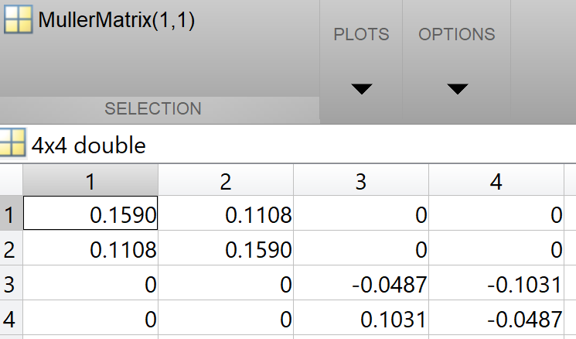
Mie scattering for Water droplet of a = 272.58467103348891669 nm, by for 500 nm wavelength of the incident light , K = 11.423973285781065 μm⁻¹, and I pick r = 10 μm
Muller matrix for 0 degree
Muller matrix for 50 degree
Muller matrix for 100 degree
Muller matrix for 150 degree
I have shown just 4 angle values. When you will run the code, you can see any value you need to check.

Slide 5
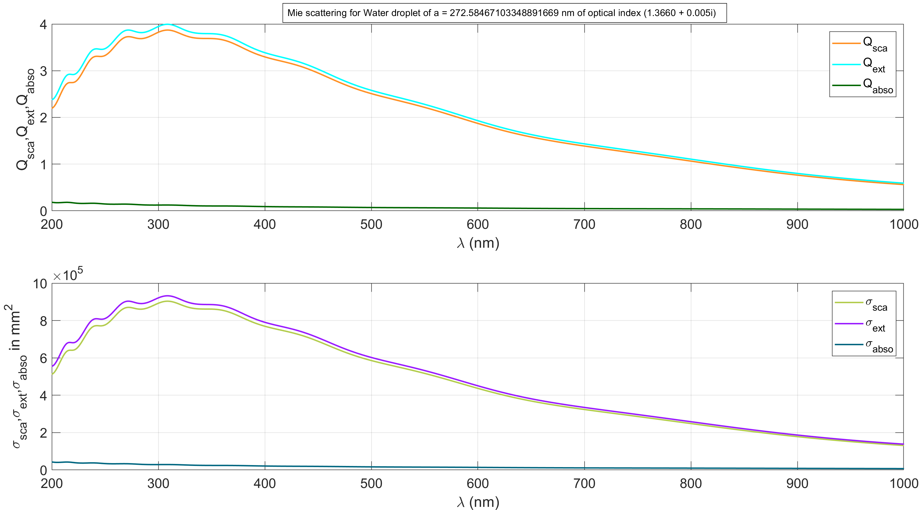
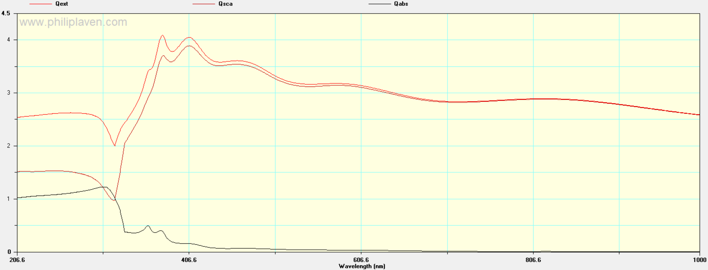
Mie scattering for Water droplet of a = 272.58467103348891669 nm, by for 200 - 1000 nm wavelength of incident light
Optical index = (1.3660 + 0.005i) Assuming same for the entire range of spectrum.
And refractive index of surrounding medium =1.
Perpendicular incident light.

Slide 6
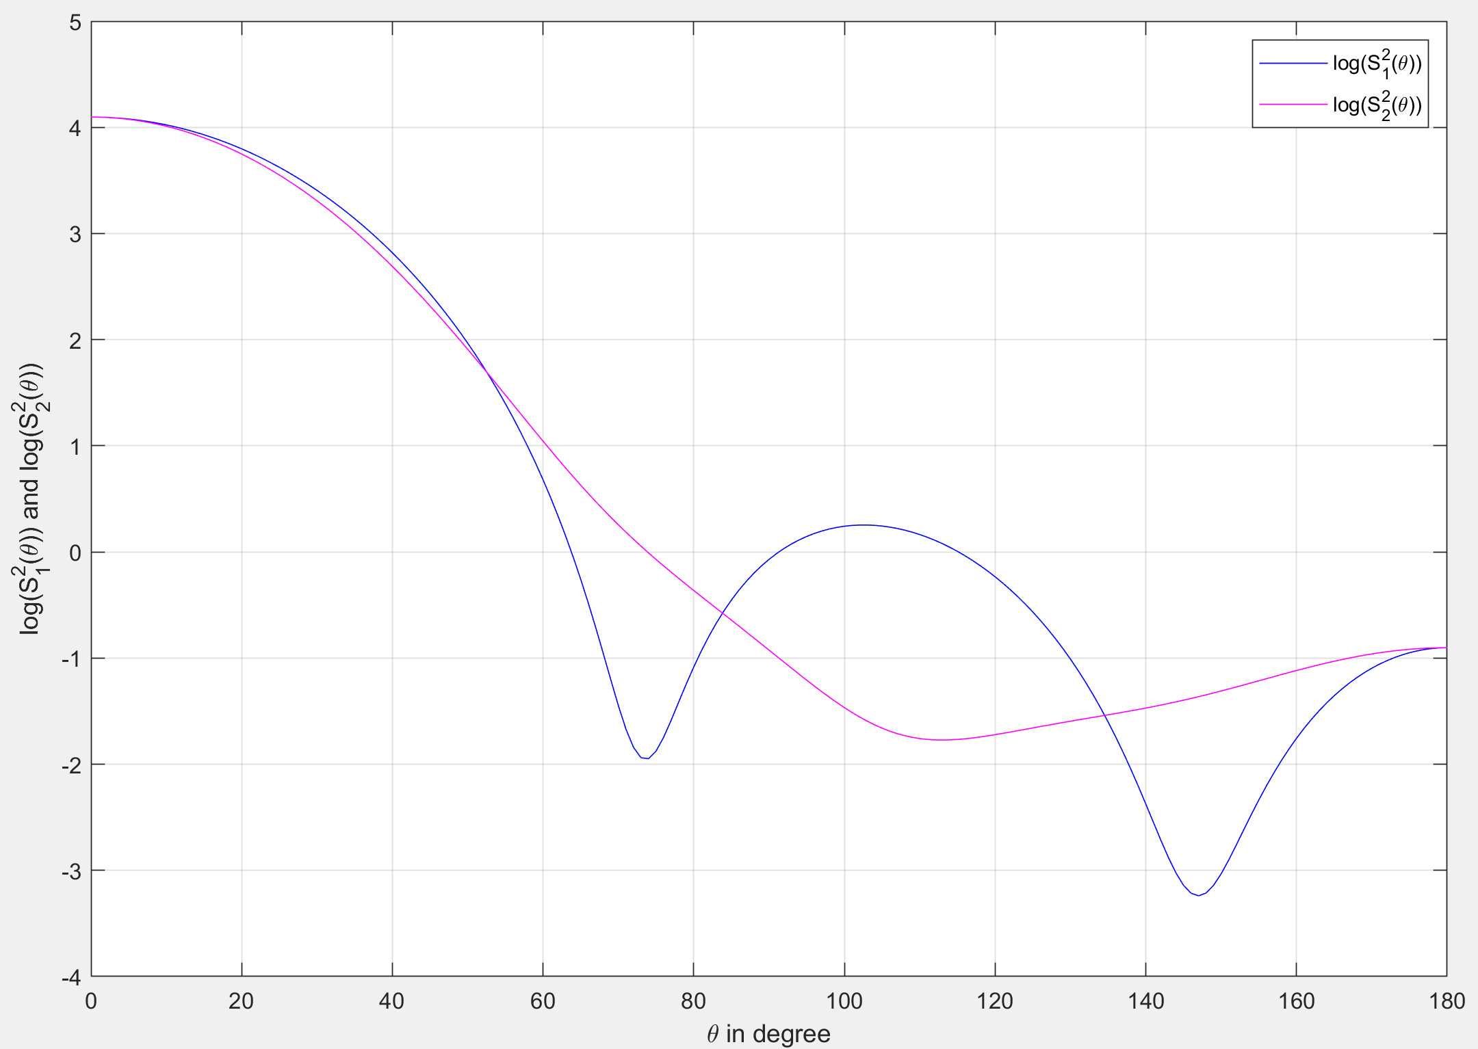
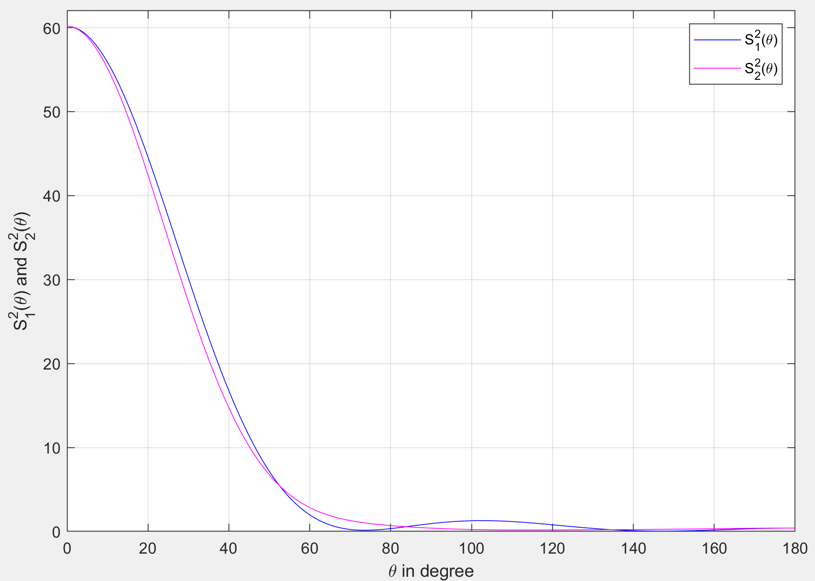
Angle depend scattering
From my code for the water droplet.
So from next slide It can if inferred that it is perpendicular polarization.

Slide 7
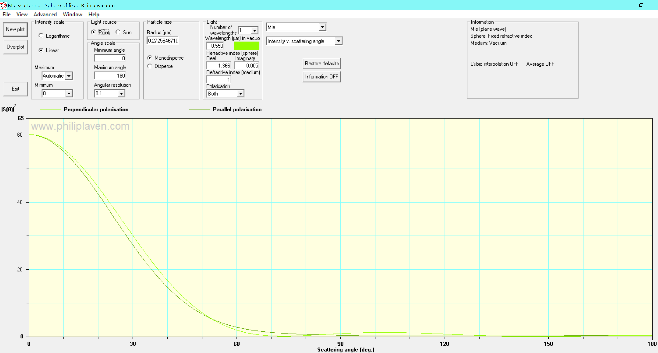
Angle depend scattering

Slide 8
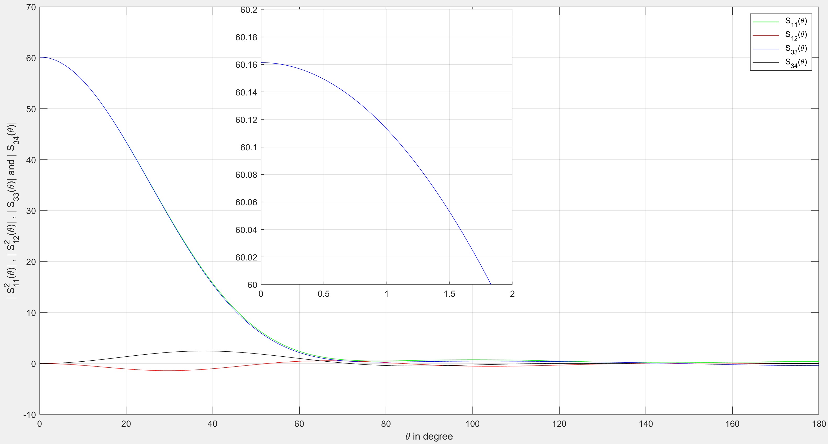
Angle depend scattering
From my code for the water droplet

Slide 9

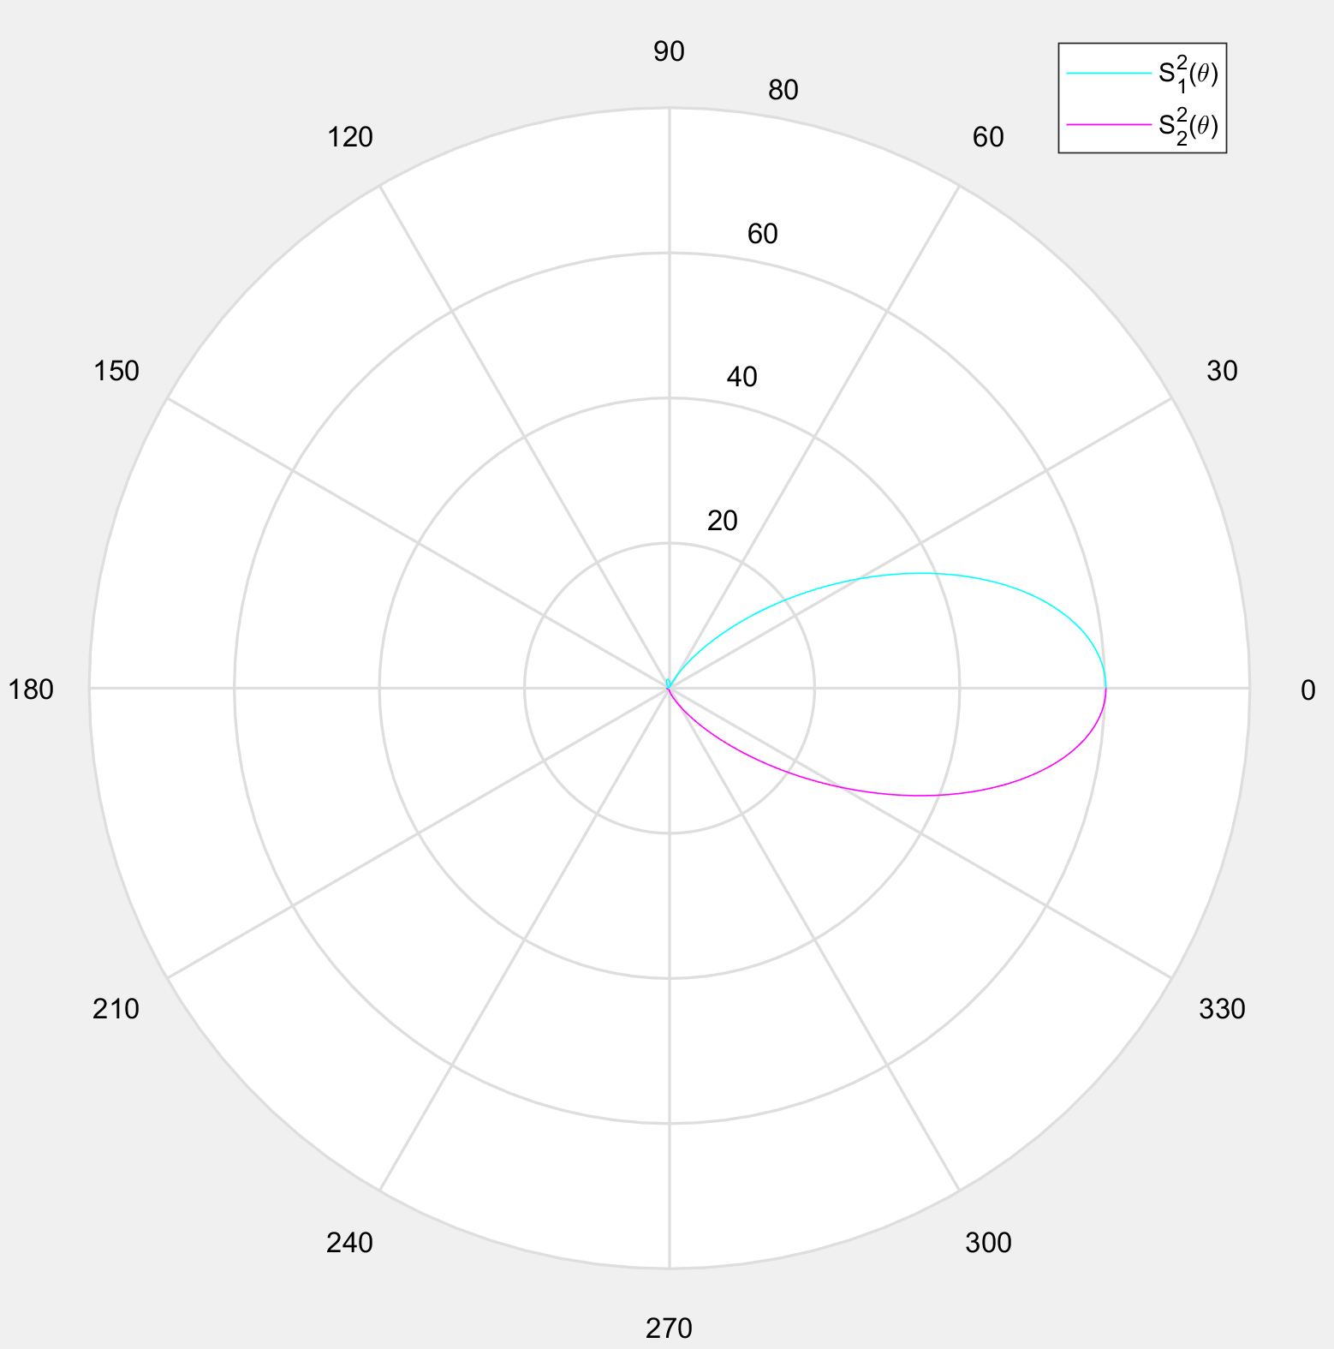
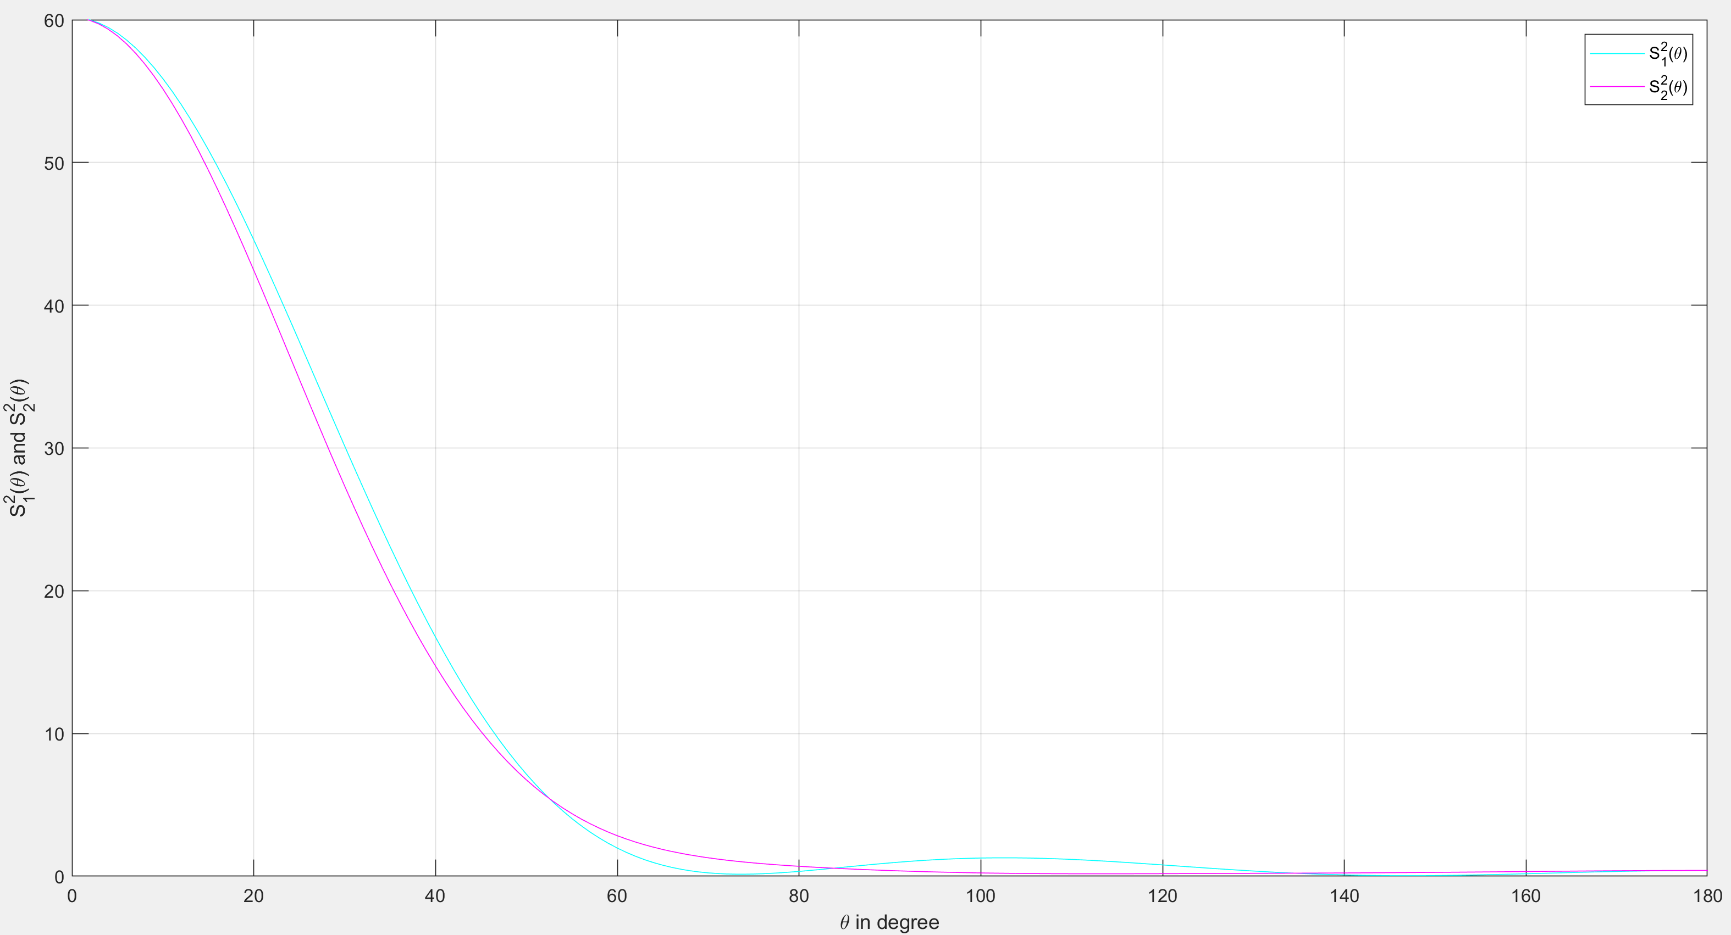
Angular Mie scattering diagram
Zoomed in at the center
ǀ S₁²(ϴ)ǀ upper half circle and
ǀ S₂²(ϴ)ǀ upper half circle
From my code for the water droplet

Slide 10
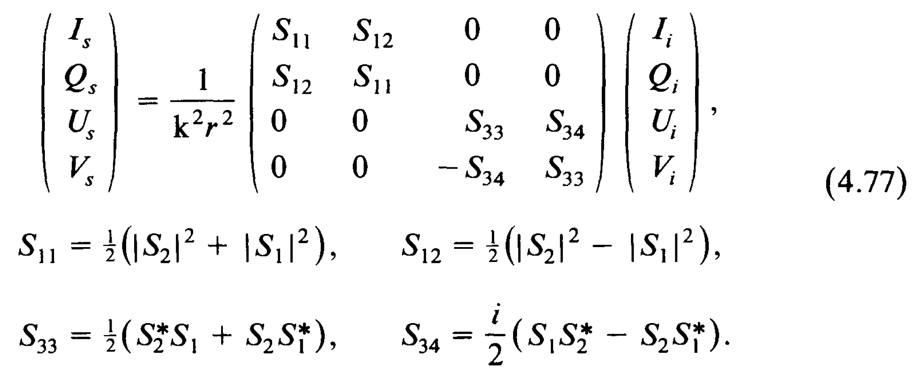
Relation between incident and scattered Stokes parameter
According to Bohren and Huffman eq:4.77 [1]
This is my calculated value from my code for ϴ =180 degree
[1] C. F. Bohren and D. R. Huffman, Absorption and scattering of light by small particles (Wiley Interscience, 1983).

Slide 11
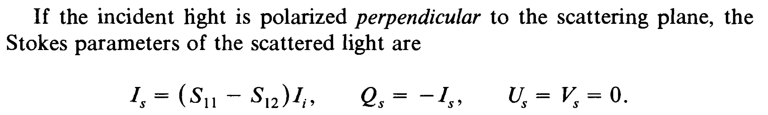
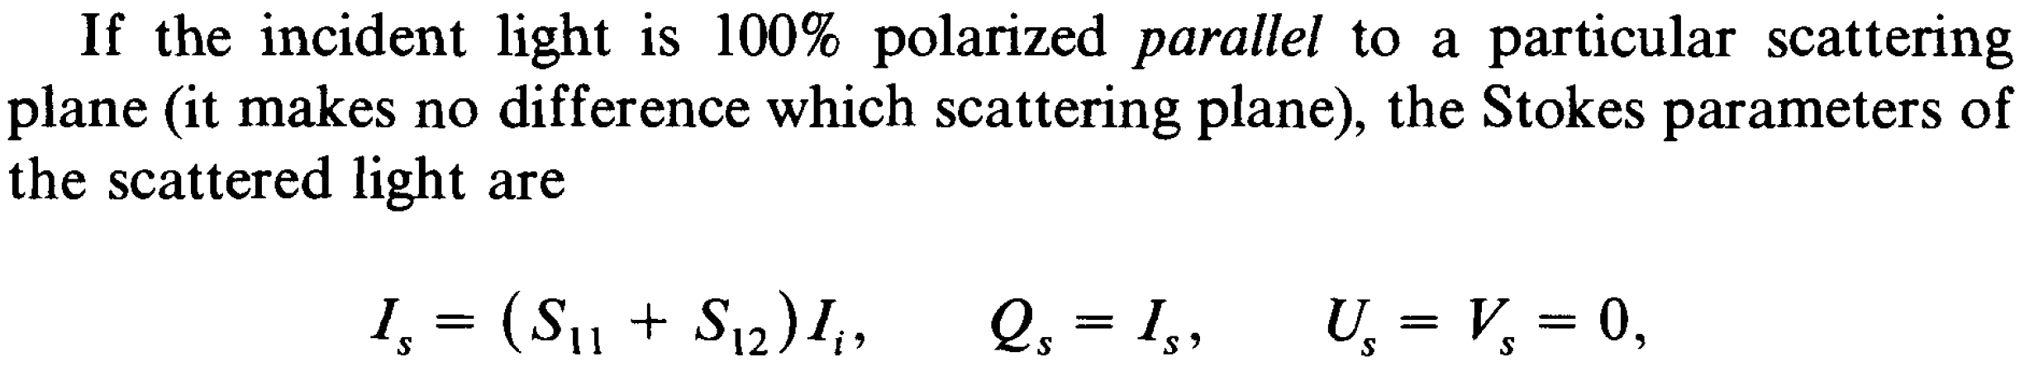
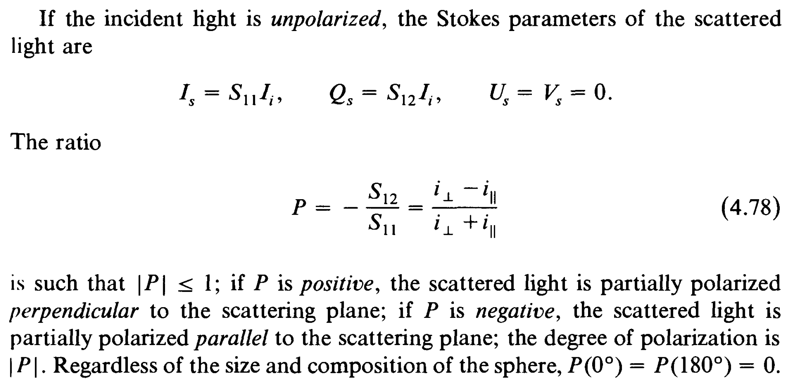
Polarization
I‖ and I_{ꓕ} are the scattered irradiance per unit incident irradiance given that the incident light is polarized parallel and perpendicular respectively to the scattering plane:
I‖ = S11 +S12 = ǀS2ǀ² I _{ꓕ} = S11 - S12 = ǀS1ǀ²
The polarization that I have calculated from my code for 0 and 180 degree scattering angles is zero.
[1] C. F. Bohren and D. R. Huffman, Absorption and scattering of light by small particles (Wiley Interscience, 1983).

Slide 12
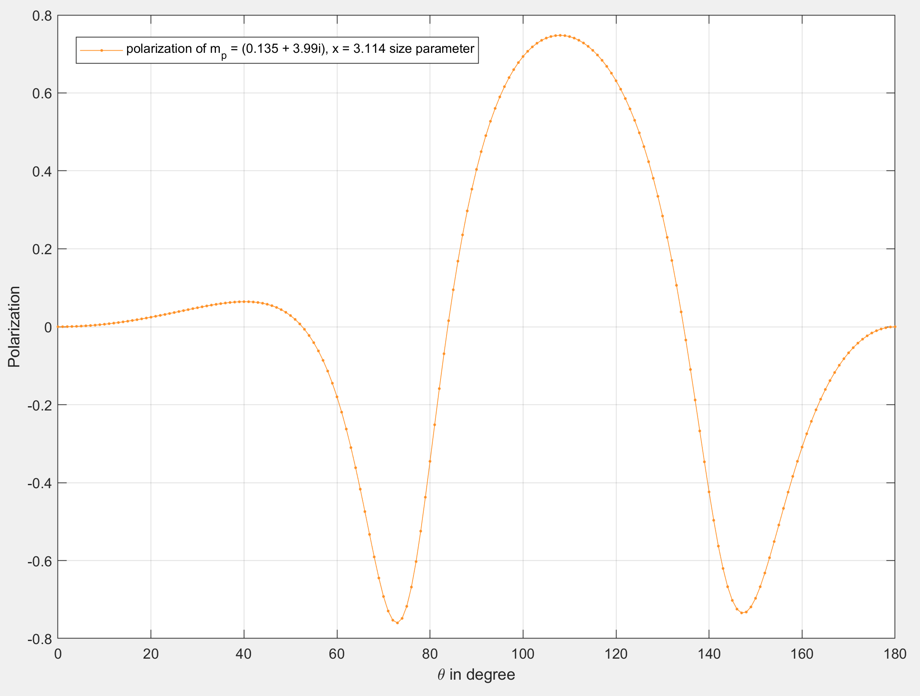
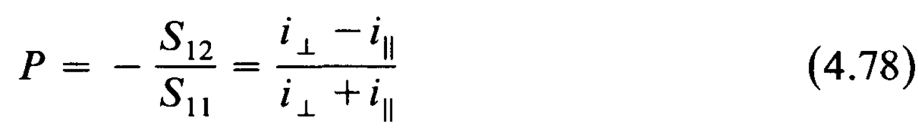
Polarization
From my code for the water droplet

Slide 13
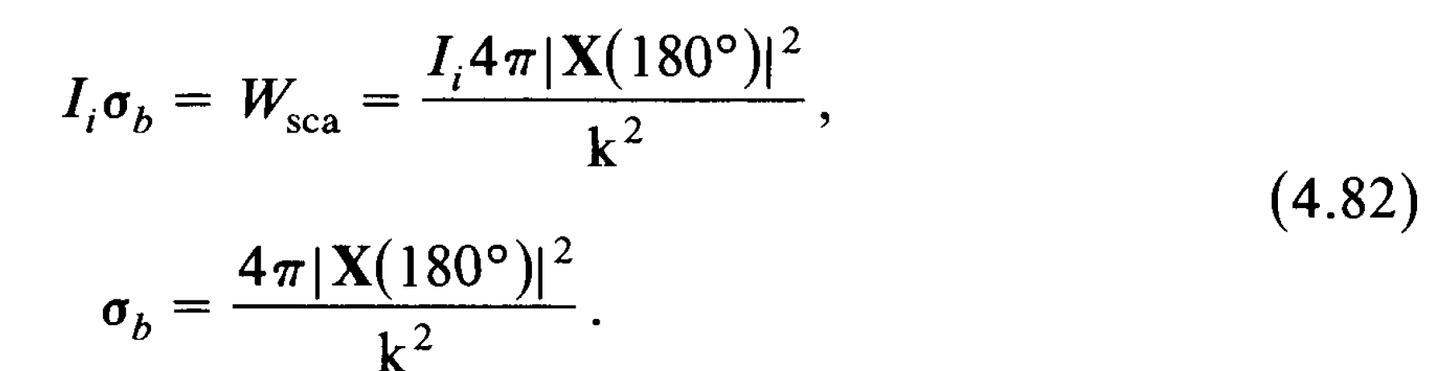
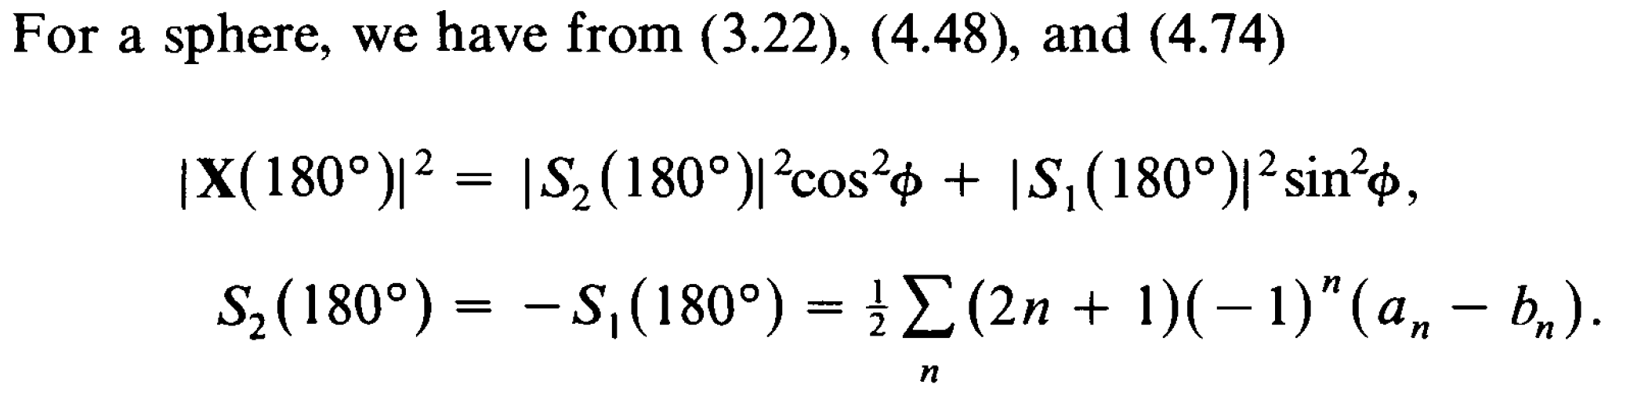
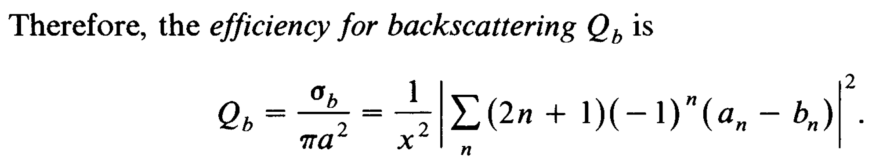
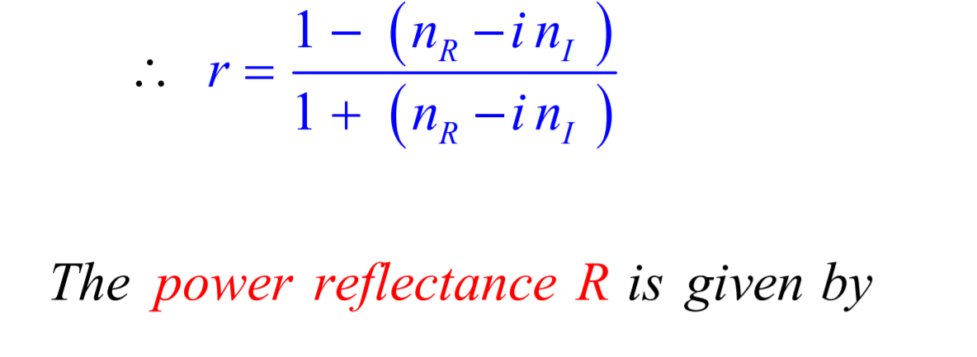
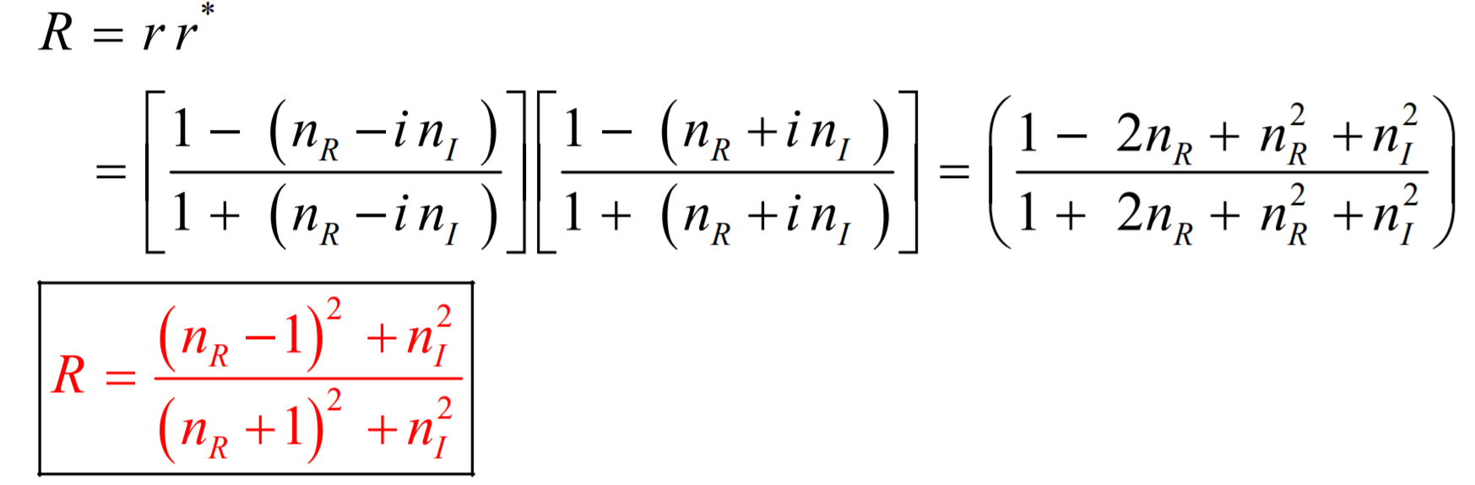
Reflectivity
Reflectivity is, R = 0.0239 for stoke vector for left circularly polarized light.
The back scattering efficiency Q_{b} = 0.0679
But using this direct equation Q_{b, direct} = 0.0012
To calculate the reflectance directly:
R = S11(180) / π a² = 0.405681031516925 / π * (0.272584671033489)² = 1.737928760842284
sa = S11(180) / K² = 0.003108496223525
Then R = sa / π a² = 0.003108496223525 / π * (0.272584671033489)² = 0.013316730559554 my calculation
[1] C. F. Bohren and D. R. Huffman, Absorption and scattering of light by small particles (Wiley Interscience, 1983).

Slide 14
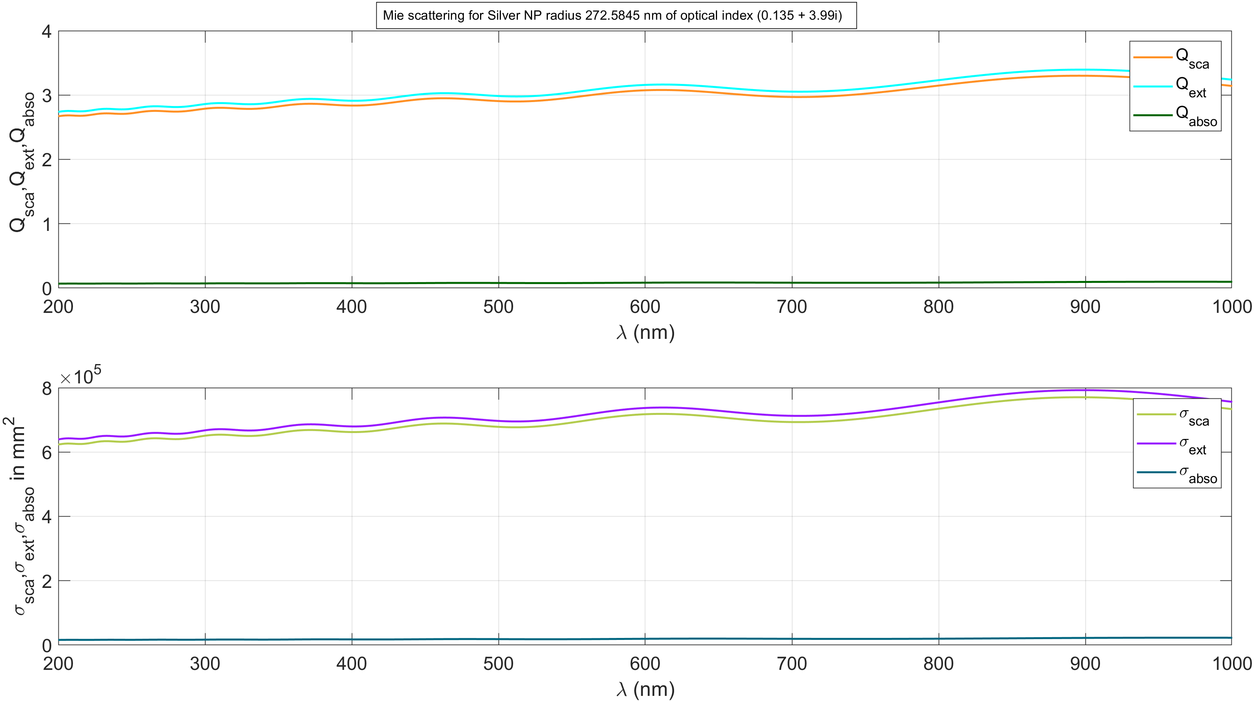
Mie scattering for Ag NP of a = 272.58467103348891669 nm, by for 200 - 1000 nm wavelength of incident light
Optical index of Ag = (0.135 + 3.99i), assume constant for whole range of spectrum.
And refractive index of surrounding medium =1.
Perpendicular incident light.

Slide 15
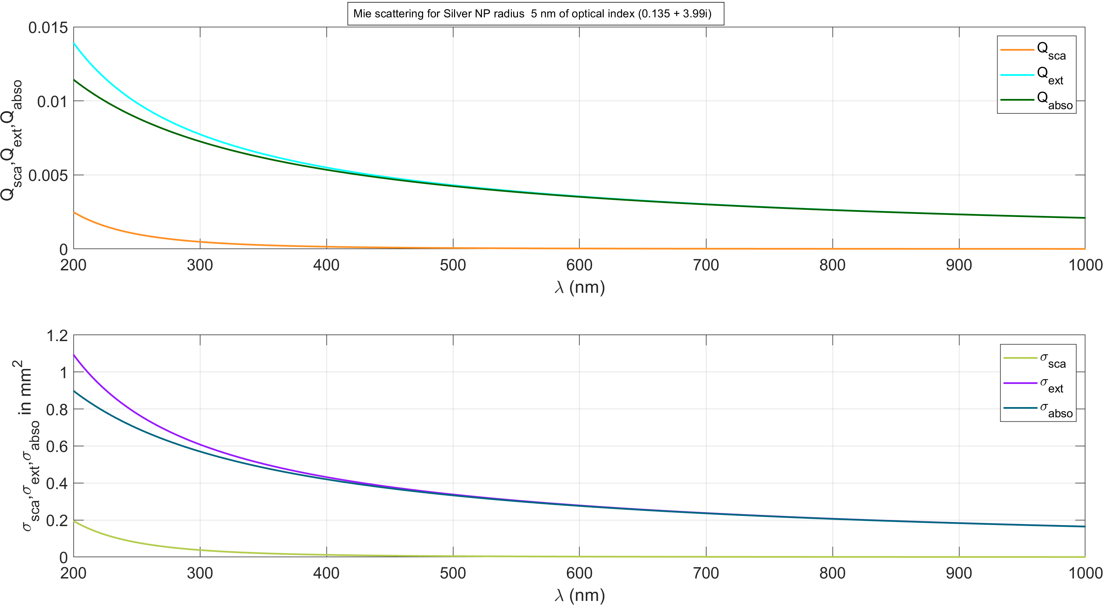
Mie scattering for Ag NP of a = 5 nm, by for 200 - 1000 nm wavelength of incident light
Optical index of Ag = (0.135 + 3.99i), assume constant for whole range of spectrum.
And refractive index of surrounding medium =1.
Perpendicular incident light.

Slide 16
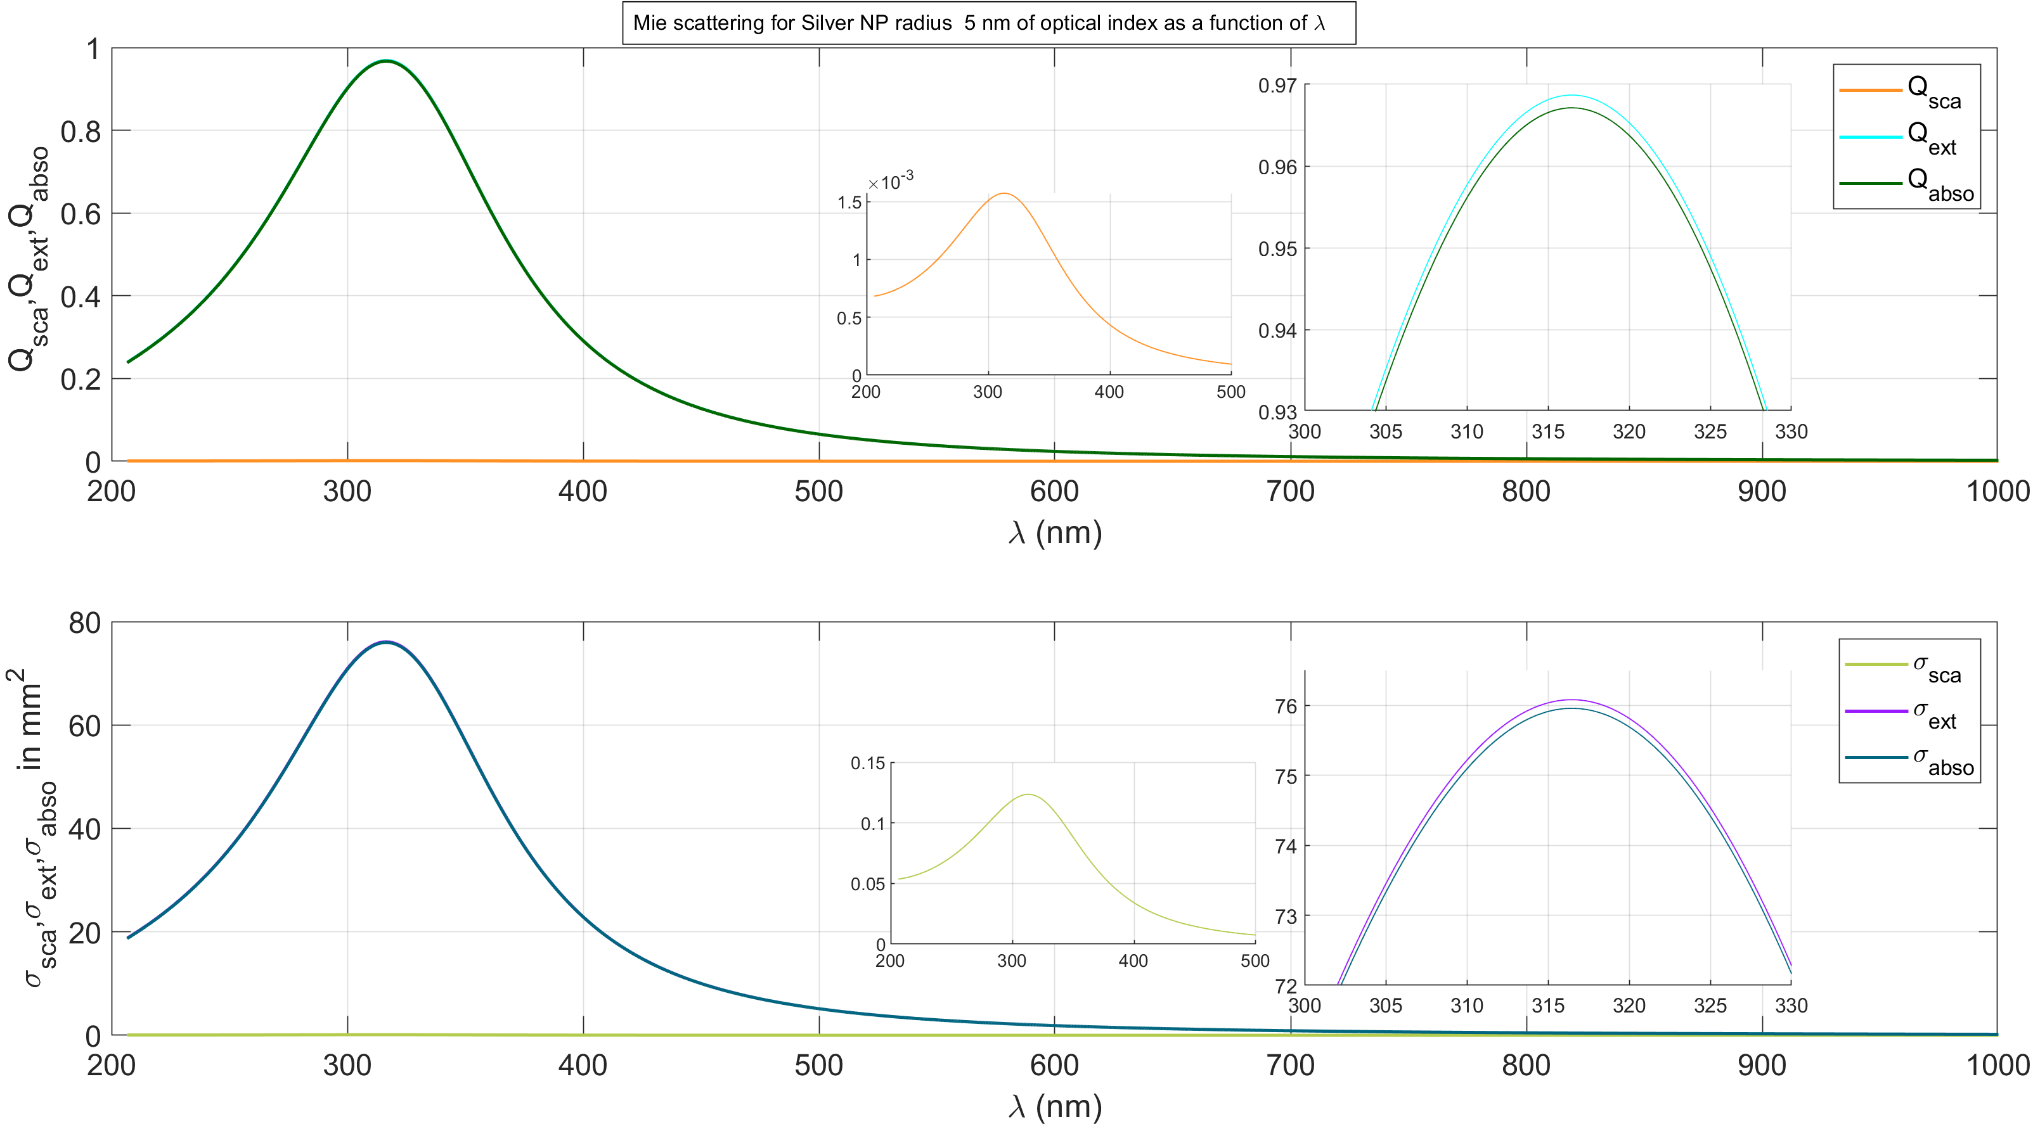
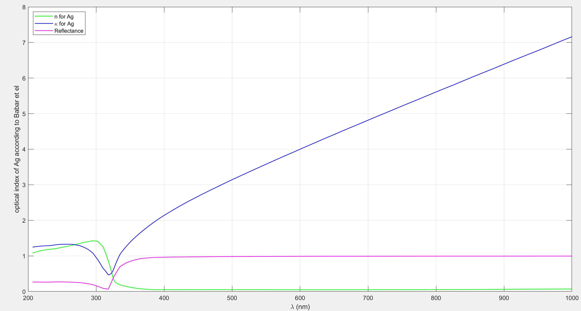
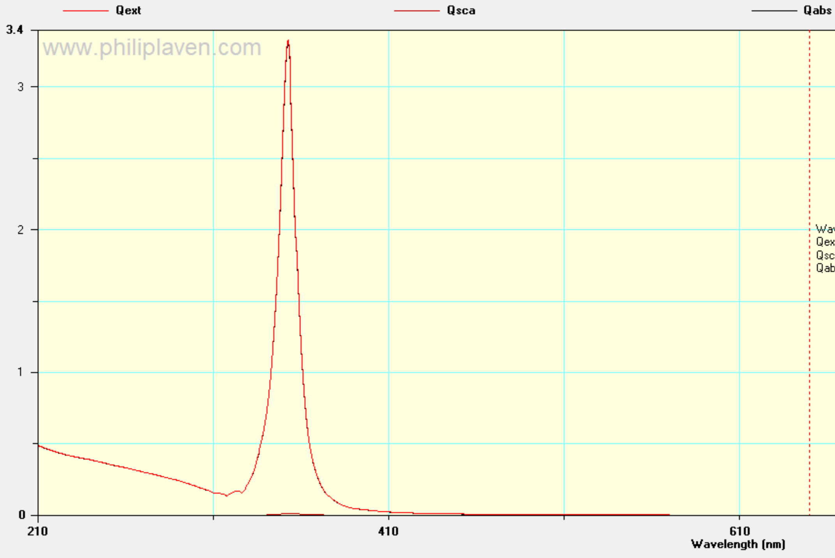
Mie scattering for Ag NP of a = 5 nm, by for 200 - 1000 nm wavelength of incident light for variable optical index
Optical index m = m(λ)
Optical index reference: S. Babar, J. H. Weaver; Optical constants of Cu, Ag, and Au revisited; APPLIED OPTICS, Vol. 54, No. 3, http://dx.doi.org/10.1364/AO.54.000477

Slide 17
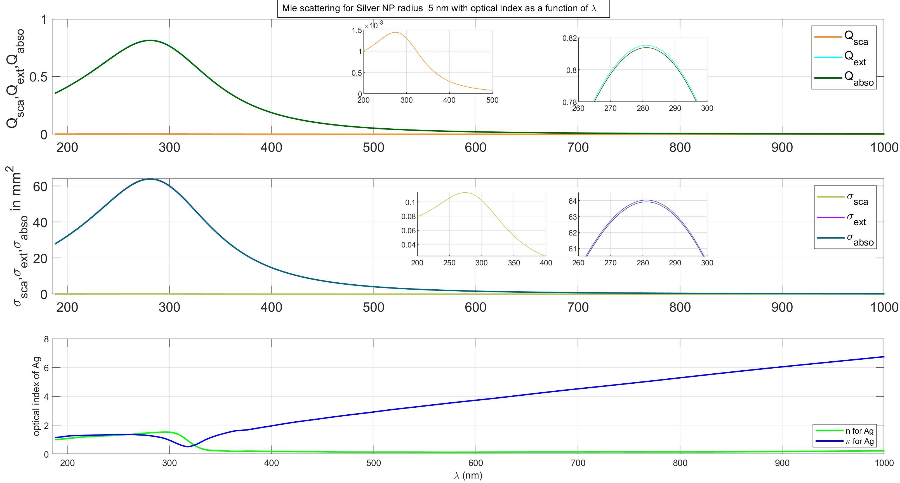
Mie scattering for Ag NP of a = 5 nm, by for 200 - 1000 nm wavelength of incident light for variable optical index
Optical index m = m(λ)
Optical index reference: Winsemius, P. et al (1976) "Temperature dependence of the optical properties of Au, Ag and Cu" J. Phys. F: Met. Phys. 6 1583 doi: 10.1088/0305-4608/6/8/017

Slide 18
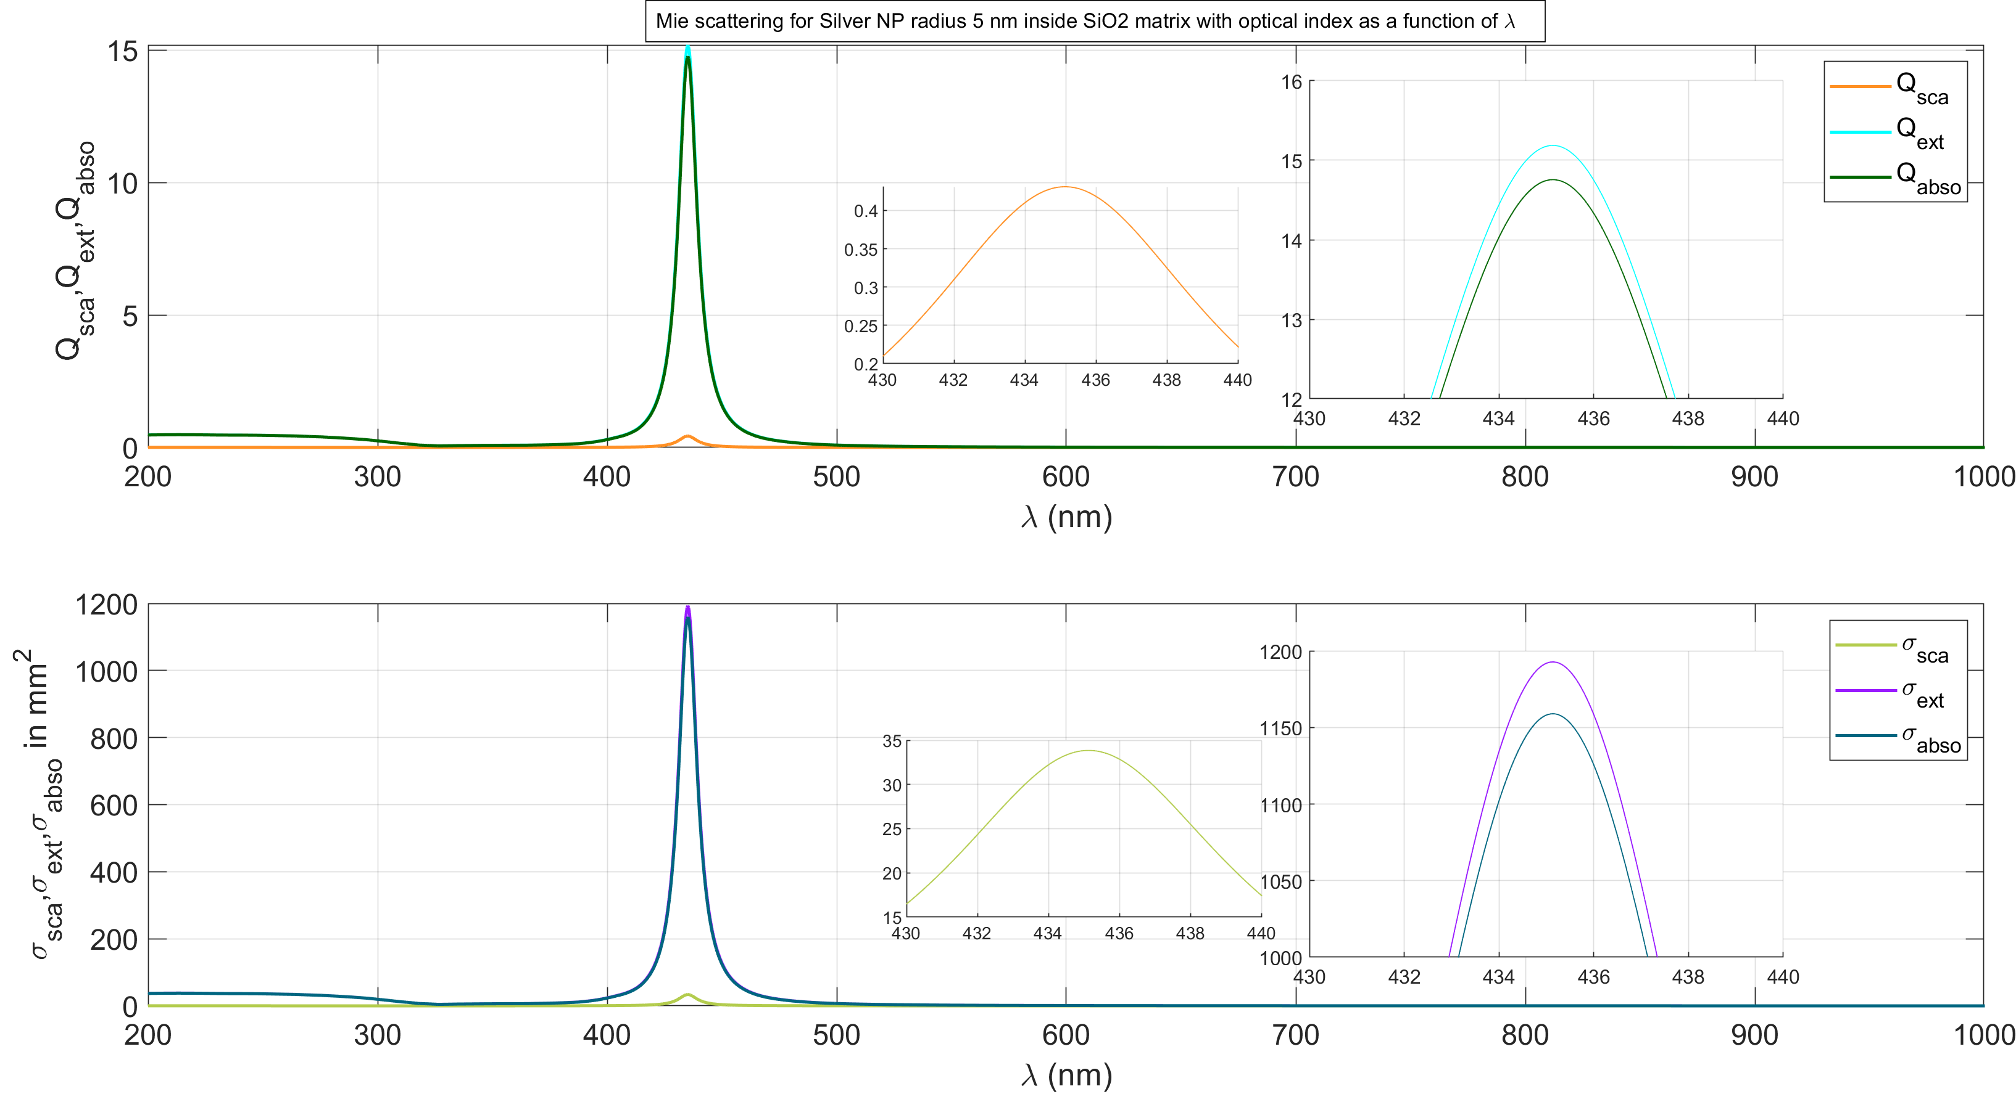
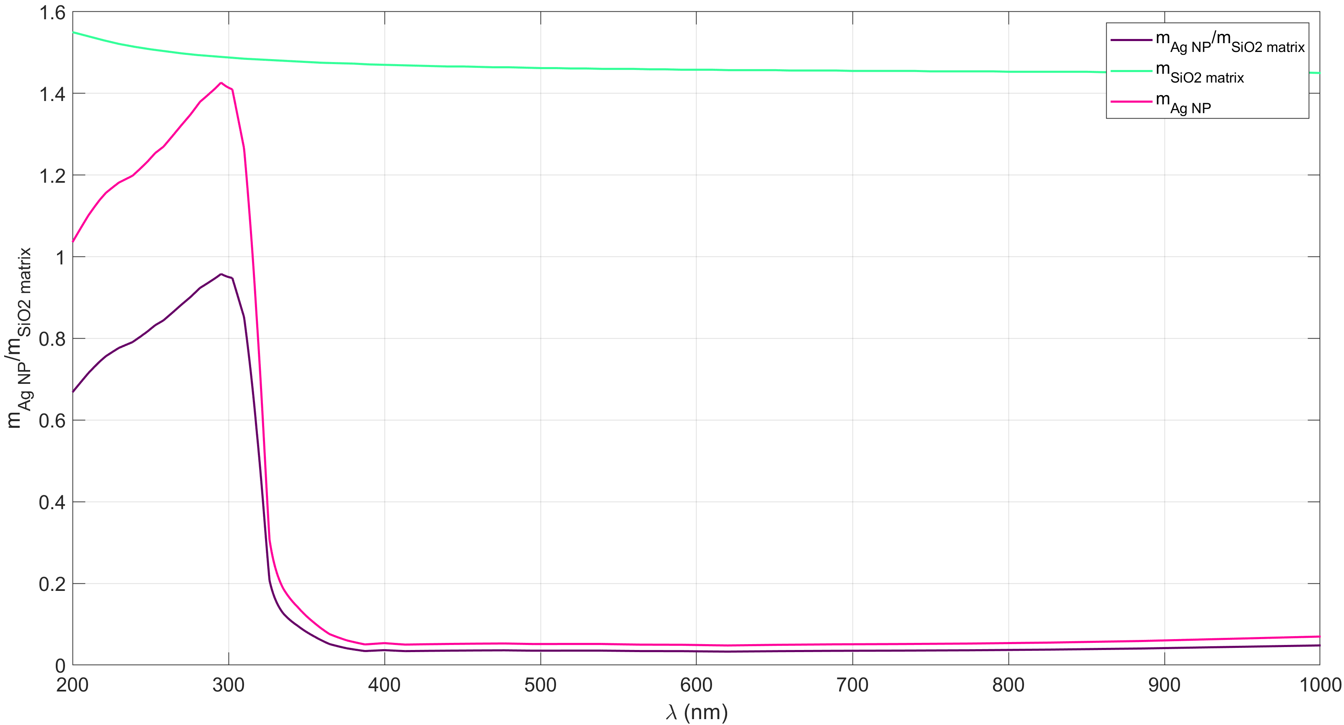
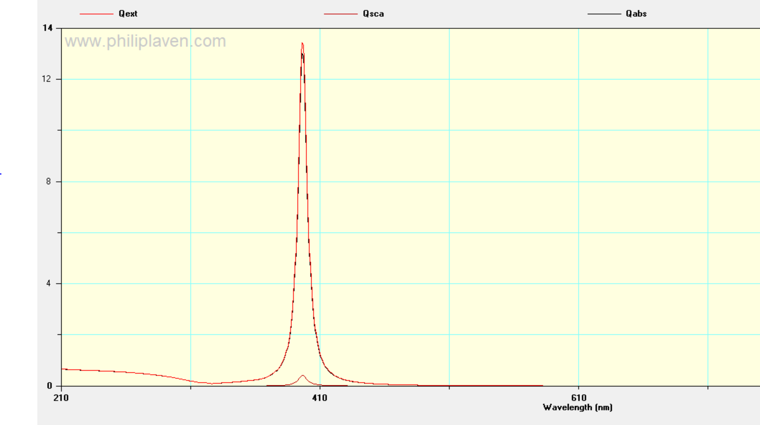
Mie scattering for Ag NP of 5 nm radius inside SiO2 matrix, by for 200 - 1000 nm wavelength of incident light for variable optical index
Optical index m = m(λ)
Optical index reference: S. Babar, J. H. Weaver; Optical constants of Cu, Ag, and Au revisited; APPLIED OPTICS, Vol. 54, No. 3, http://dx.doi.org/10.1364/AO.54.000477.
Optical index reference for SiO2: E. Palik, Handbook of Optical Constants of Solids Vol I, Academic Press, Orlando, pp. 759–0.

Slide 19
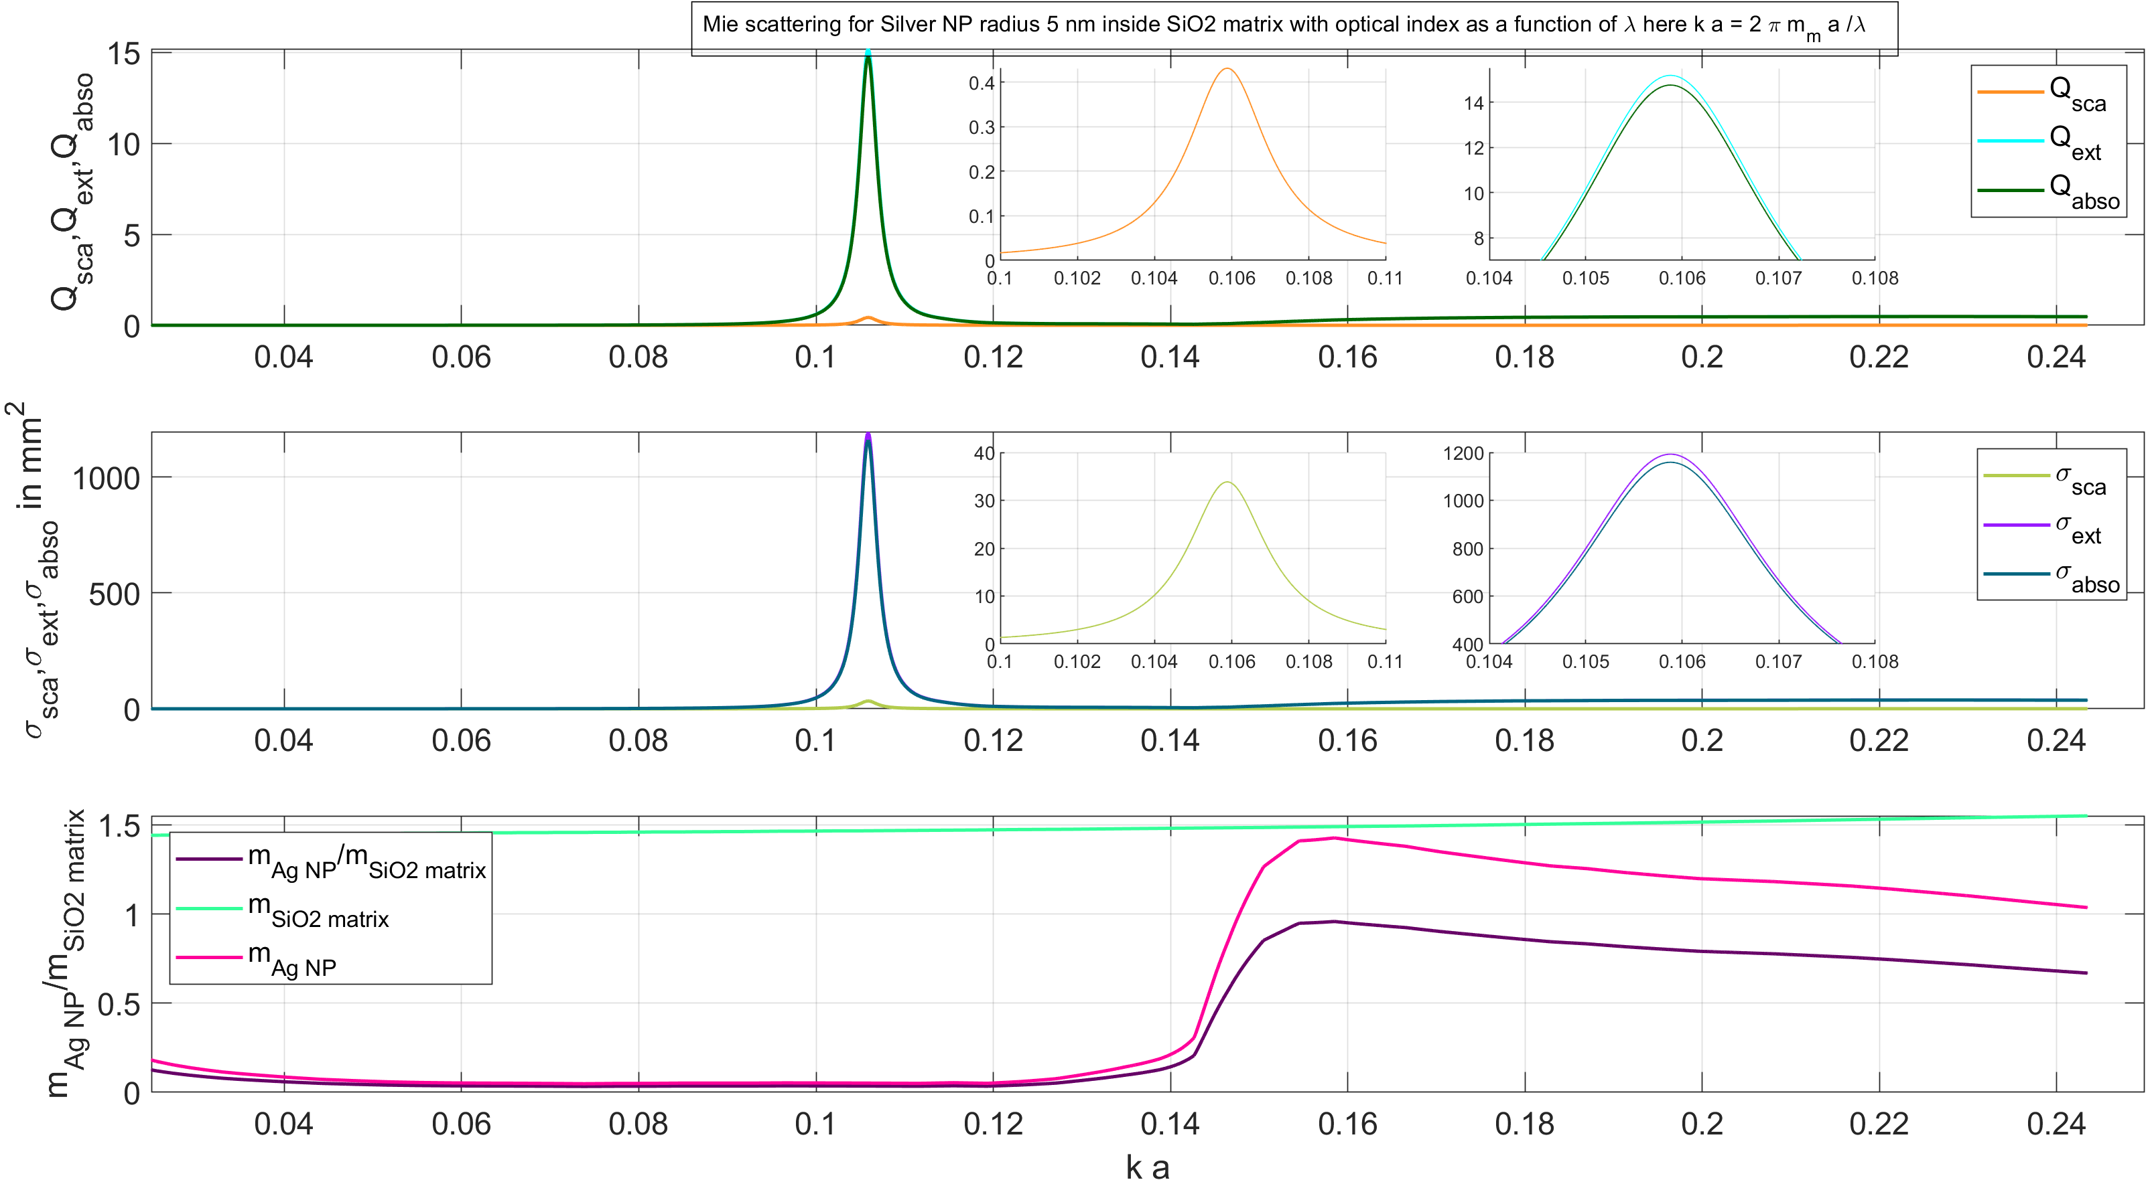
Mie scattering for Ag NP of 5 nm radius inside SiO2 matrix, by for 200 - 1000 nm wavelength of incident light for variable optical index
Optical index m = m(λ)
Optical index reference: S. Babar, J. H. Weaver; Optical constants of Cu, Ag, and Au revisited; APPLIED OPTICS, Vol. 54, No. 3, http://dx.doi.org/10.1364/AO.54.000477.
Optical index reference for SiO2: E. Palik, Handbook of Optical Constants of Solids Vol I, Academic Press, Orlando, pp. 759–0.

Slide 20
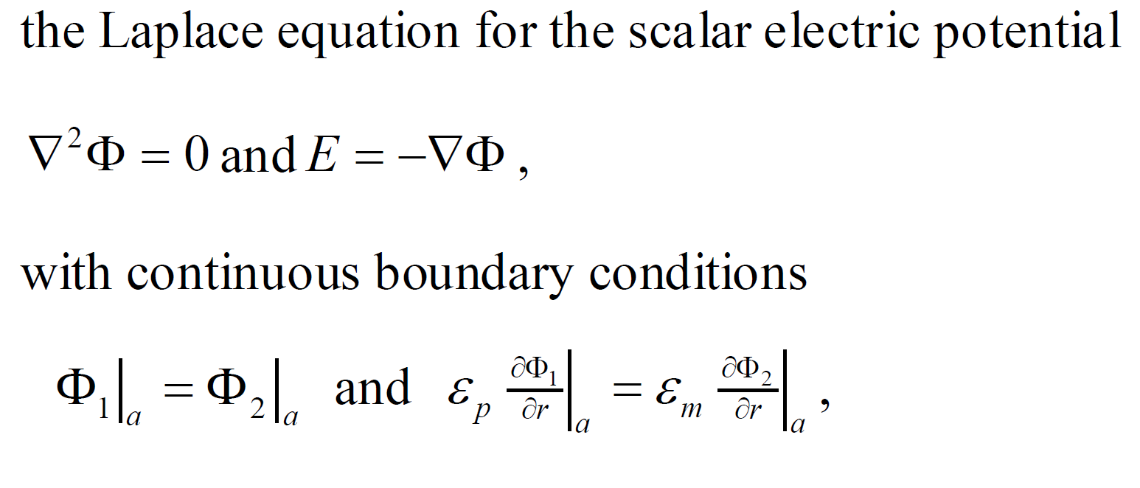
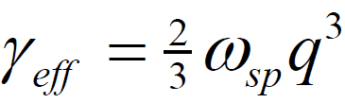
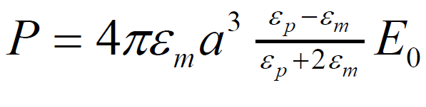
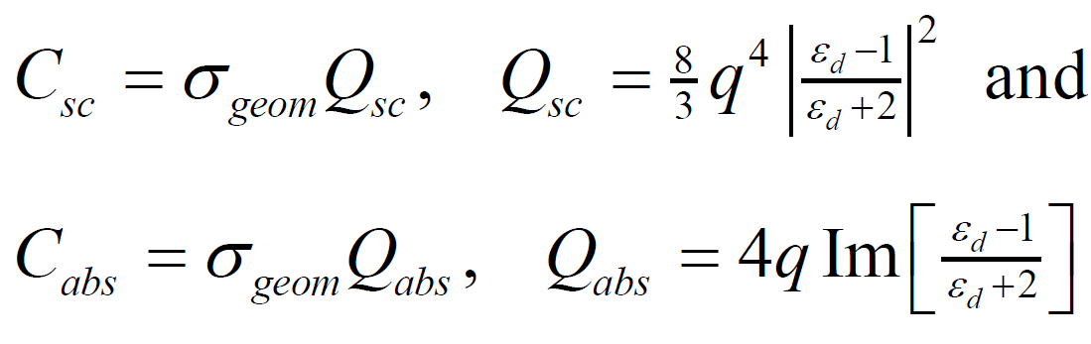
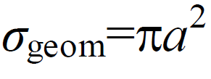
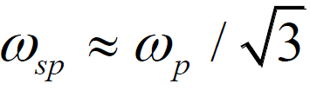
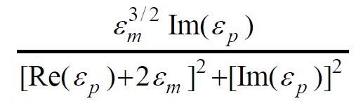
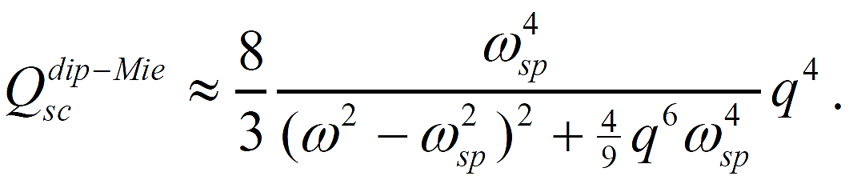
Domination of over-scattering with particle size decrease and shift of resonance pick [1]
note that the dissipative losses due to electron collisions γ , is ignored in the derivation. The spectrum is found to have a Lorentz profile with an effective parameter γeff, which has a similar role as the dissipation parameter in the Rayleigh spectrum and can be expressed as
This damping is due to the radiative losses of plasmons. This is different from the dissipative loss term γ in Rayleigh formula. Therefore, the singularity in the corrected scattering formula is removed due to radiative losses, even if dissipative losses are neglected.
from the Laplace equation with that of a dipole, the effective dipole moment can be expressed
Intuitively, the red shift of the peak in the dipole resonance with increasing size is due to the weakening of the restoring force. This is because the distance between charges on opposite sides of the particle increases with size and so their interaction decreases. The red shift of resonance can be addressed directly by numerical solution of the Mie theory equations. The scattering cross-section, Csc from the dipole term neglecting dissipative losses is plotted in Figure 1a. The red shift is clearly seen. One may also note that the resonant scattering cross-section is similar for the different sizes. However, with dissipative losses, the scattering cross-section falls quickly with decreasing particle size. Clearly, the effect of dissipative losses on the scattering increases with decreasing size. The effect of the dielectric function of the medium, εm on the plasmon resonance of small metal particles is contained in the parameters q and εd. From equation. Cabs is proportional to
the dimensionless size q=ka and the relative dielectric function εd =εp/εm ,
The above formula implies that as the particle size is decreased, the efficiency of absorption will dominate over the scattering efficiency. Therefore, particles with very small size will be difficult to detect by light scattering. In addition, one may note that there is a resonant enhancement for scattering and absorption when the condition Re(εd)=-2 (the Fröhlich condition) is satisfied. This resonance is due to resonant excitation of the dipole surface plasmon. With the Drude model of dielectric function, the frequency of the dipole surface plasmon can be expressed as , if the frequency of electron collisions is small. The spectrum for the scattering cross section is Lorentz line shape. But The above theory, however, doesn’t capture the size effects on the spectra, including the changes of position and width of plasmon peak. Retardation effects in larger particles result in breakdown of the quasi-static approximation
The Fröhlich resonance condition then requires a decrease in Re(εp), for an increase in εm. For most metals, such as Au and Ag, Re(εp) decreases and Im(εp) increases with decreasing frequency around the resonance. Therefore, the peaks in the absorption spectra are shifted to longer wavelengths and become broader and more intense with the increase in εm
At the Fröhlich resonance condition in the formula
[1] C. F. Bohren and D. R. Huffman, Absorption and scattering of light by small particles (Wiley Interscience, 1983).

Slide 21
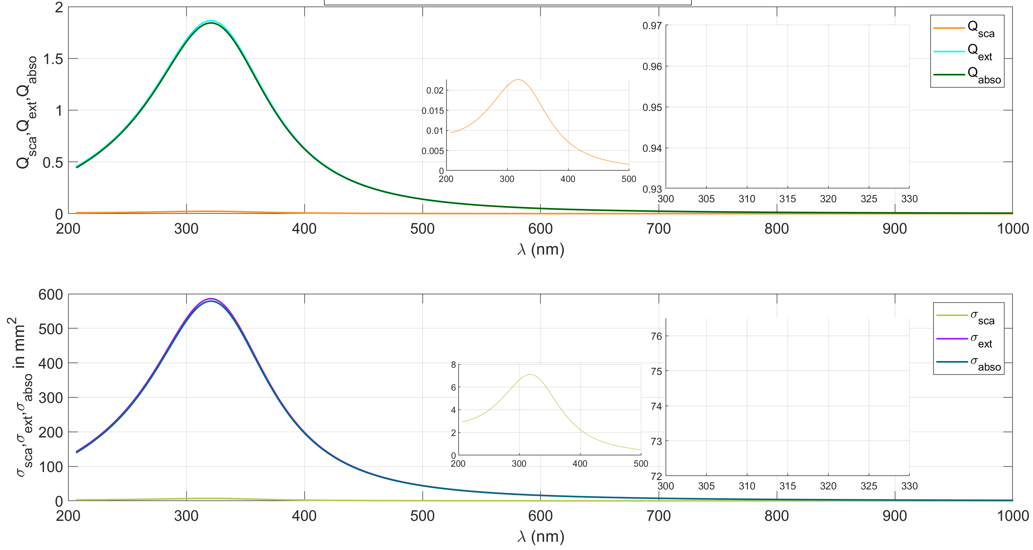
Ag np 10 nm size

Slide 22
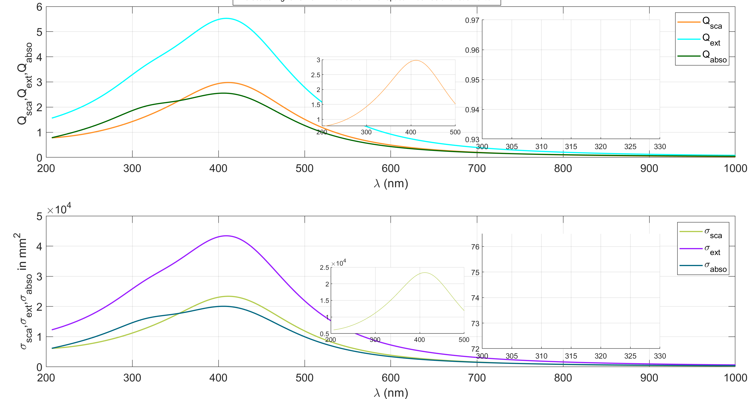
Ag Np 50 nm size

Slide 23
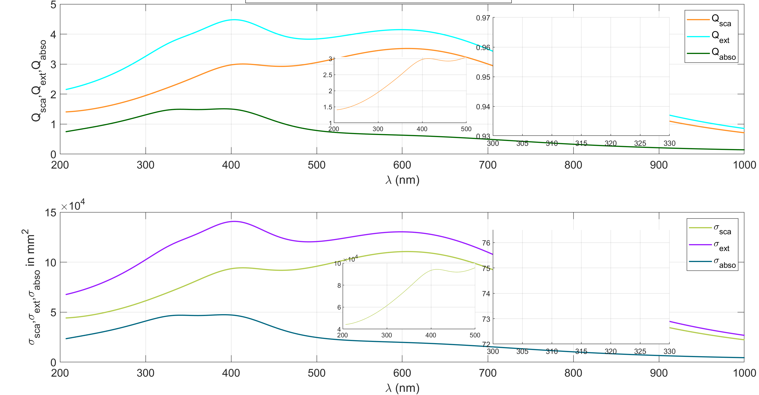
Ag Np 100 nm size

